Slide 1


IC Training Center Vietnam
Fundamentals of Digital IC Design: RTL Design and Verification
Final Project RTL Design and Verification of Timer IP
Class: IC11 – Student: Phạm Duy Quang

Slide 2
CONTENTS
01
Design Specification
02
RTL Design
03
Design Verification
04
Simulation Result

Slide 3
1.1. Timer Features
The timer has following features:
64-bit count-up.
Address space: 4KB (0x4000_1000 – 0x4000_1FFF).
Register set is configured via APB bus (IP is APB slave).
Support wait state (1 cycle) and error handling.
Support byte access.
Support halt (stop) in debug mode.
System clock frequency is 200 MHz. Timer uses active low async reset.
Counter can be counted based on system clock or divided up to 256.
Support timer interrupt (can be enabled or disabled).

Slide 4
1.2. Detail Functional Description – Counter
The counter specification is describes as following:
64-bit count-up.
Counting mode:
Default mode: counter’s speed is same as system clock.
Control mode: when enabled by writing 1 to TCR.div_en bit, the counter's speed is determined by the divisor value set in TCR.div_val.
Counter continues counting when interrupts occurs.
Counter continues counting when overflow occurs.
Support halted mode.
When timer_en changes from High to Low, the counter is cleared to its initial value. When timer_en transitions back from Low to High again, timer can work normally.
Note: the div_en and div_val is not related to frequency divisor (clock divider). Those settings only control the counter when to count.

Slide 5
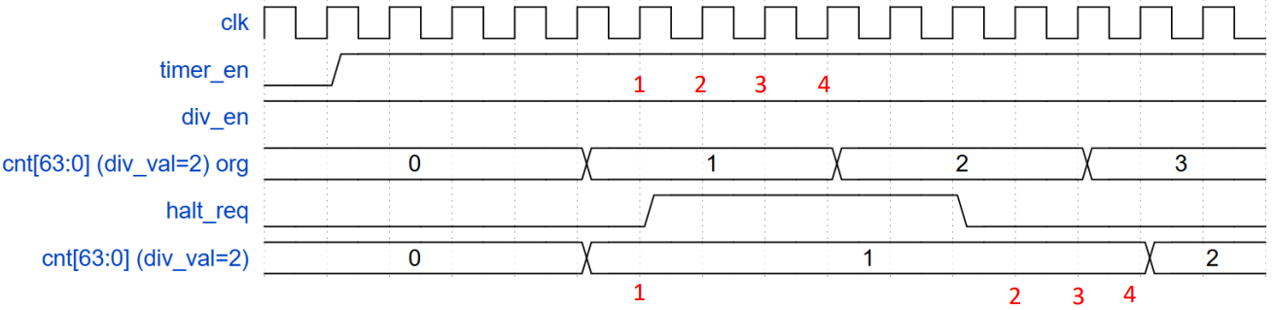
1.2. Detail Functional Description – Halted
Halt mode:
Counter can be halted (stopped) in debug mode when both below conditions occur:
Input debug_mode signal is High.
THCR.halt_req is 1.
THCSR.halt_ack is 1 after a halt request indicates that the request is accepted.
After halted, counter can be resumed to count normally when clearing the halt request to 0.
The period of each counting number needs to be the same when halt and not halt as described in the below waveform example (div_val = 2).

Slide 6
1.2. Detail Functional Description – Timer Interrupt
Timer interrupt:
Timer interrupt (tim_int) is asserted (set) when interrupt is enabled and counter’s value matches (equal) the compare value.
Once asserted, the timer interrupt (tim_int) remains unchange until it is cleared by writing 1 to TISR.int_st bit or the interrupt is disabled.

Slide 7
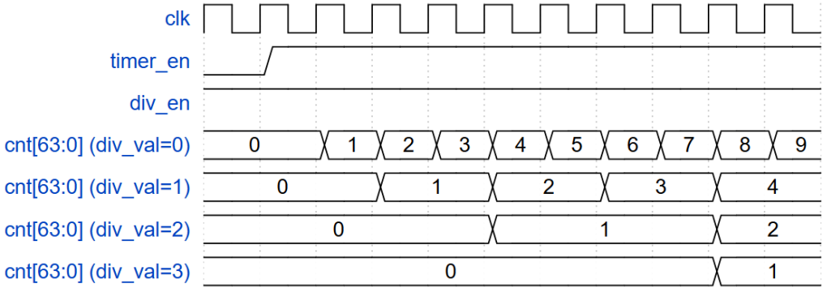
1.2. Detail Functional Description – Counting Mode
Counting mode:
In default mode, counting speed depend on system clock (same as div_val = 0 case as below waveform).
The counting’s speed can be controlled by register settings by setting into TCR.div_en and TCR.div_val [3:0] as the register specification.
div_en and div_val cannot be changed during timer_en is High.
Not allow to change div_en and div_val while timer_en is High by an error response when user mistakenly accesses.
Example waveform of counter in control mode.

Slide 8
1.2. Detail Functional Description – APB slave / Register
APB slave / Register:
Address space: 4KB (0x4000_1000 – 0x4000_1FFF).
Read/write to reserved area is RAZ/WI (read as zero, write ignored).
System clock frequency is 200 MHz.
Support byte access: bus can access to individual bytes in the register.
Support wait state (1 cycle) to improve the timing.
Support error handling for some prohibited access:
write prohibited value to TCR.div_val.
div_en or div_val changes during timer is operating.
When error occurs, data is not written into register bits/fields.

Slide 9
1.3. Register Specification – Register Summary
Base address: 0x4000_1000
Offset | Abbreviation | Register name
0x00 | TCR | Timer Control Register
0x04 | TDR0 | Timer Data Register 0
0x08 | TDR1 | Timer Data Register 1
0x0C | TCMP0 | Timer Compare Register 0
0x10 | TCMP1 | Timer Compare Register 1
0x14 | TIER | Timer Interrupt Enable Register
0x18 | TISR | Timer Interrupt Status Register
0x1C | THCSR | Timer Halt Control Status Register
Others | Reserved

Slide 10
1.3. Register Specification – Timer Control Register (TCR)
Bit | Name | Type | Default value | Description
31:12 | Reserved | - | 20’h0 | Reserved
11:8 | div_val | RW | 4’b0001 | Counter control mode setting: 4’b0000: Counting speed is not divided. 4’b0001: Counting speed is divided by 2 (default). 4’b0010: Counting speed is divided by 4. 4’b0011: Counting speed is divided by 8. 4’b0100: Counting speed is divided by 16. 4’b0101: Counting speed is divided by 32. 4’b0110: Counting speed is divided by 64. 4’b0111: Counting speed is divided by 128. 4’b1000: Counting speed is divided by 256. Others: reserved, prohibit settings. When setting the prohibit value, div_val is not changed. Note: User must not change div_en while timer_en is High. Add hardware logic to ensure div_val is prohibited to change when timer_en is High. Access is error response in this case. Access is “error response” when setting prohibit value to div_val.
7:2 | Reserved | RO | 6’b0 | Reserved
1 | div_en | RW | 1’b0 | Counter control mode enable. 0: Disabled. Counter counts with normal speed based on system clock. 1: Enabled. The couting speed of counter is controlled based on div_val. Note: User must not change div_en while timer_en is High. Add hardware logic to ensure div_en is prohibited to change when timer_en is High. Access is error response in this case.
0 | timer_en | RW | 1’b0 | Timer enable 0: Disabled. Counter does not count. 1: Enabled. Counter starts counting. Timer_en changes from H->L will initialize the TDR0/1 to their initial value.

Slide 11
1.3. Register Specification – Timer Data Register 0 (TDR0)
Bit | Name | Type | Default value | Description
31:0 | TDR0 | RW | 32’h0000_0000 | Lower 32-bit of 64-bit counter. Value of this register is cleared to initial value when timer_en changes from H->L.

Slide 12
1.3. Register Specification – Timer Data Register 1 (TDR1)
Bit | Name | Type | Default value | Description
31:0 | TDR1 | RW | 32’h0000_0000 | Upper 32-bit of 64-bit counter. Value of this register is cleared to initial value when timer_en changes from H->L.

Slide 13
1.3. Register Specification – Timer Compare Register 0 (TCMP0)
Bit | Name | Type | Default value | Description
31:0 | TCMP0 | RW | 32’hFFFF_FFFF | Lower 32-bit of 64-bit compare value. Interrupt is asserted when counter value is equal to compare value.

Slide 14
1.3. Register Specification – Timer Compare Register 1 (TCMP1)
Bit | Name | Type | Default value | Description
31:0 | TCMP1 | RW | 32’hFFFF_FFFF | Upper 32-bit of 64-bit compare value. Interrupt is asserted when counter value is equal to compare value.

Slide 15
1.3. Register Specification – Timer Interrupt Enable Register (TIER)
Bit | Name | Type | Default value | Description
31:1 | Reserved | RO | 31’h0 | Reserved
0 | int_en | RW | 1’b0 | Timer interrupt enable 0: Timer interrupt is disabled. 1: Timer interrupt is enabled. When this bit is 0, no timer interrupt is output. When this bit is 1, timer interrupt can be output when reaching trigger condition. Clearing this bit to 0 while interrupt is asserting will mask the interrupt to 0 but does not affect the interrupt pending bit TISR.int_st bit.

Slide 16
1.3. Register Specification – Timer Interrupt Status Register (TISR)
Bit | Name | Type | Default value | Description
31:1 | Reserved | RO | 31’h0 | Reserved
0 | int_st | RW1C | 1’b0 | Timer interrupt trigger condition status bit (interrupt pending bit) 0: the interrupt trigger condition does not occur. 1: the interrupt trigger condition occurred. Write 1 when this bit is 1 to clear it. Write 0 when this bit is 1 has no effect. Write to this bit when it is 0 has no effect. Note: When interrupt trigger condition occurred (counter reached compare value), counter continues to count normally.

Slide 17
1.3. Register Specification – Timer Halt Control Status Register (THCSR)
Bit | Name | Type | Default value | Description
31:2 | Reserved | RO | 30’h0 | Reserved
1 | halt_ack | RO | 1’b0 | Timer halt acknowledge 0: timer is NOT halted 1: timer is halted Timer accepts the halt request only in debug mode, indicates by debug_mode input signal.
0 | halt_req | RW | 1’b0 | Timer halt request 0: no halt req. 1: timer is requested to halt.

Slide 18
2.1. IO Port List
Top module name: timer_top
Signal name | Width | Direction | Description
sys_clk | 1 | Input | Input clock signal for the timer module.
sys_rst_n | 1 | Input | Active-low asynchronous reset signal 0: The counter is in reset state 1: The counter is in non-reset state
tim_psel | 1 | Input | APB select signal to indicate the timer module is selected for a transaction.
tim_pwrite | 1 | Input | APB write control signal 0: Read operation 1: Write operation
tim_penable | 1 | Input | APB enable signal to initiate the data phase of a transaction.
tim_paddr | 12 | Input | APB address bus to specify the register address. Note: The bit-width must accommodate the address space.
tim_pwdata | 32 | Input | APB write data bus to provide data for write transactions.
tim_prdata | 32 | Output | APB read data bus to return data during read transactions.
tim_pstrb | 4 | Input | APB byte strobe signal for specifying valid write data bytes.
tim_pready | 1 | Output | APB ready signal to indicate the timer module has completed the transaction.
tim_pslverr | 1 | Output | APB error signal to indicate an invalid or unsupported transaction.
tim_int | 1 | Output | Timer interrupt signal triggered when the timer generates an interrupt.
dbg_mode | 1 | Input | Debug mode signal to enable or disable debug functionality for the timer.

Slide 19
2.2. Block diagram
sys_clk
timer_top
sys_rst_n
dbg_mode
Timer control
Timer counter
tim_prdata [31:0]
timer_en
APB slave
wr_en
Register file
div_en
tim_pready
cnt_en
tim_pslverr
rd_en
div_val [3:0]
halt_req
APB bus
halt_ack
tdr0/1_wr_en
TDR [63:0]
tcmp [63:0]
addr [11:0]
cnt_val [63:0]
wdata [31:0]
cmp_match
rdata [31:0]
reg_err
int_en
Timer interrupt
tim_int
int_st

Slide 20
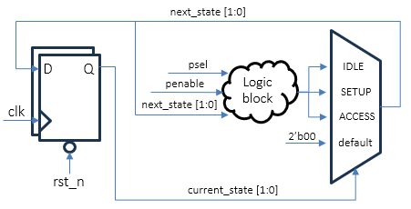
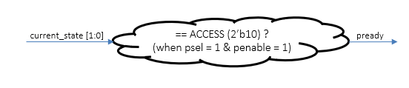
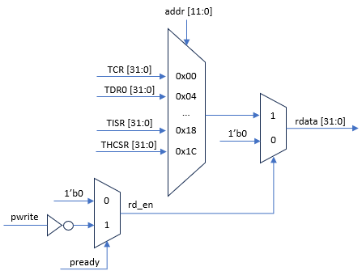
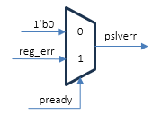
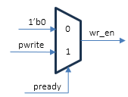
2.3. Logic diagram – APB slave

Slide 21
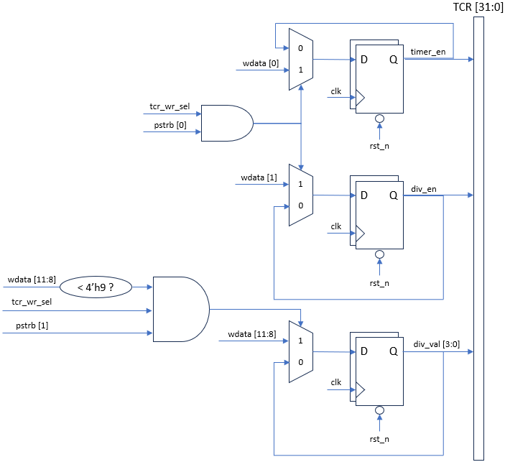

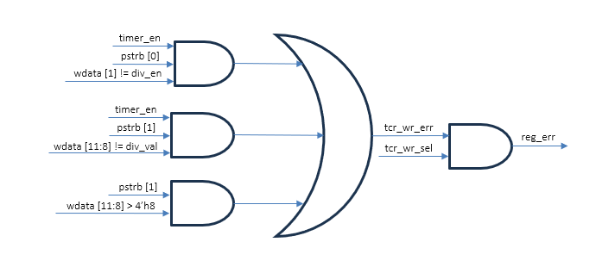
2.3. Logic diagram – Timer Control Register

Slide 22
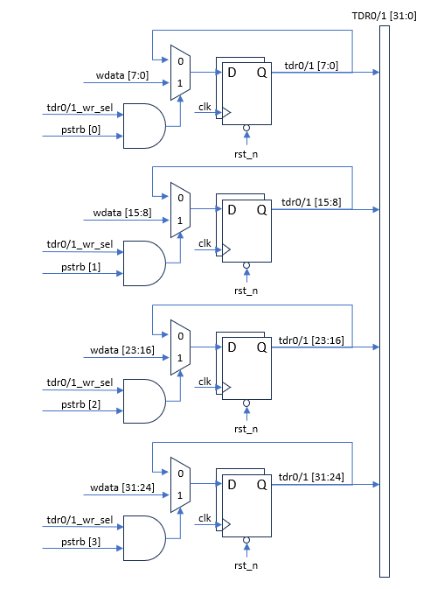
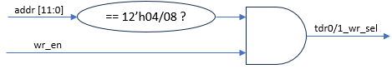
2.3. Logic diagram – Timer Data Register 0 / 1

Slide 23
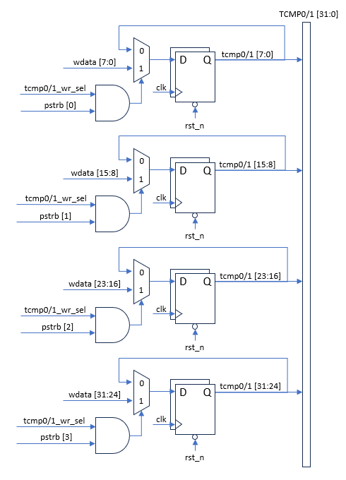
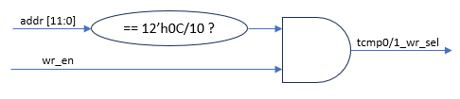
2.3. Logic diagram – Timer Compare Register 0 / 1

Slide 24
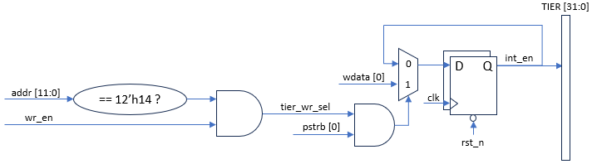
2.3. Logic diagram – Timer Interrupt Enable Register

Slide 25
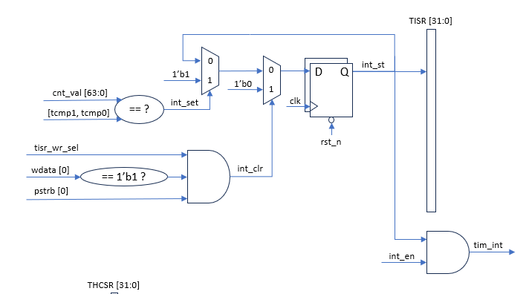

2.3. Logic diagram – Timer Interrupt Status Register

Slide 26
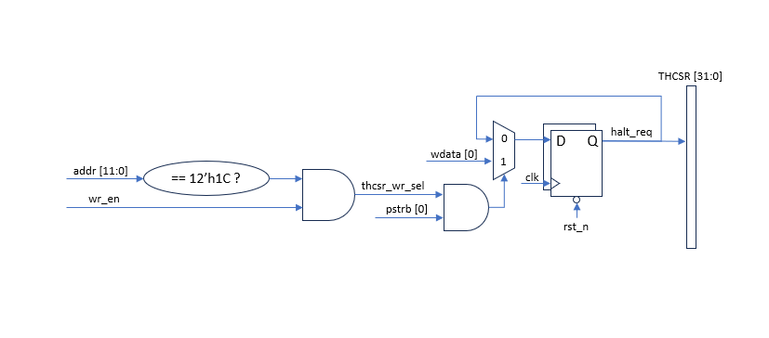
2.3. Logic diagram – Timer Halt Control Status Register

Slide 27
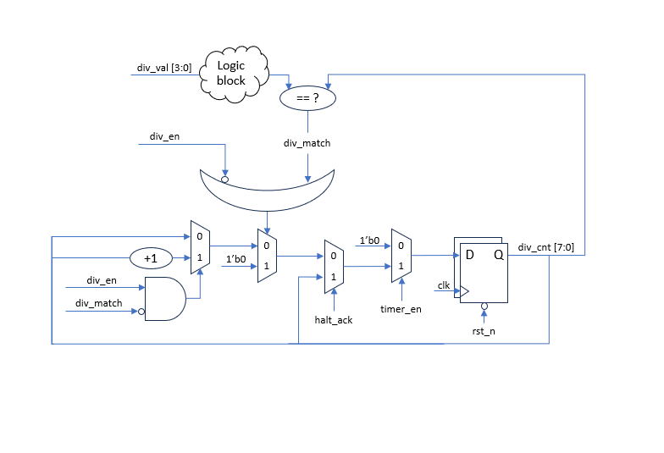
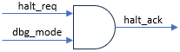
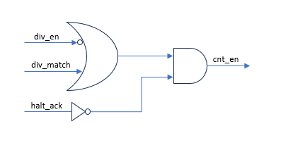
2.3. Logic diagram – Timer Control

Slide 28
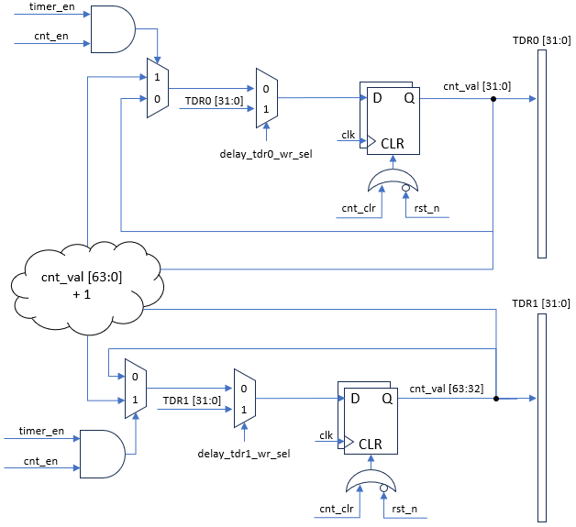
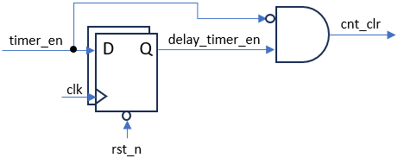
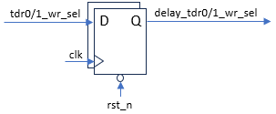
2.3. Logic diagram – Timer Counter

Slide 29
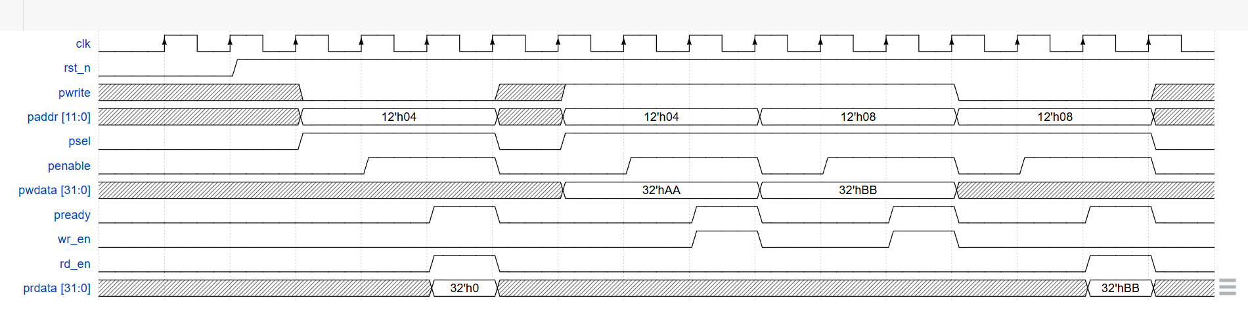
2.4. Waveform – APB with wait state (1 cycle)

Slide 30
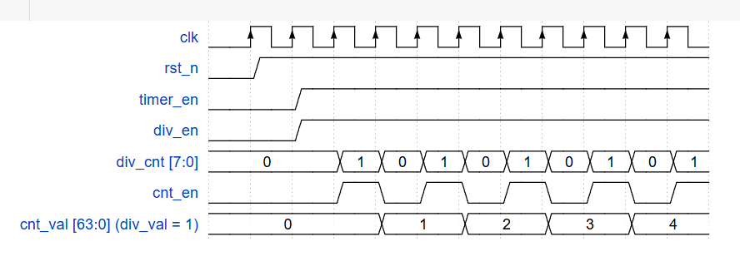
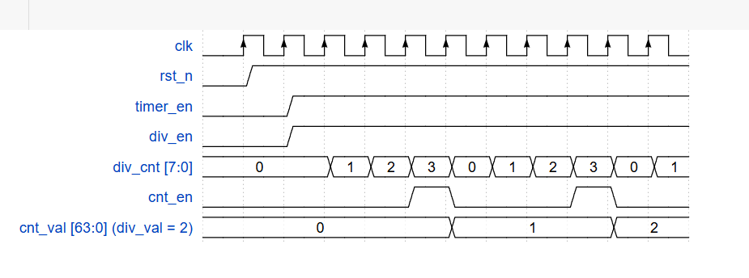
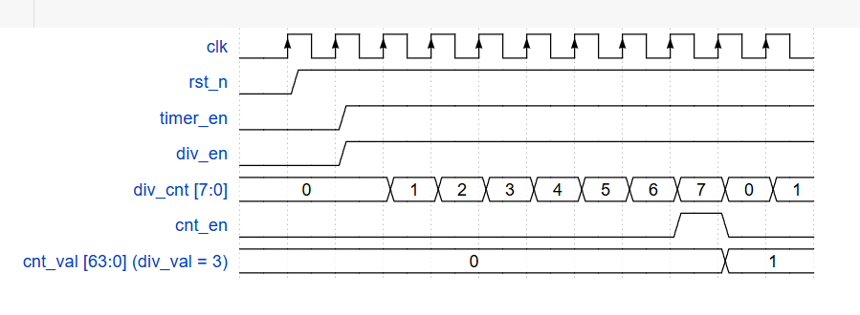
2.4. Waveform – Counter control mode
1
2
3

Slide 31
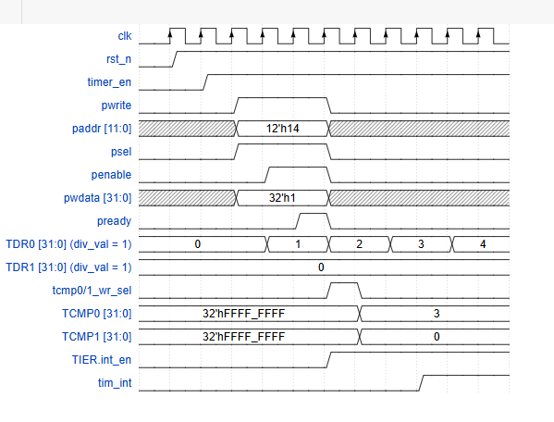
2.4. Waveform – Interrupt assert condition

Slide 32
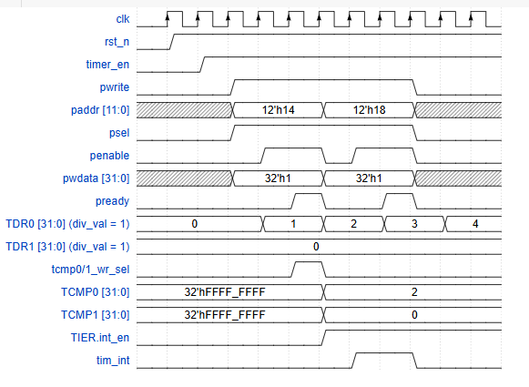
2.4. Waveform – Interrupt clear

Slide 33
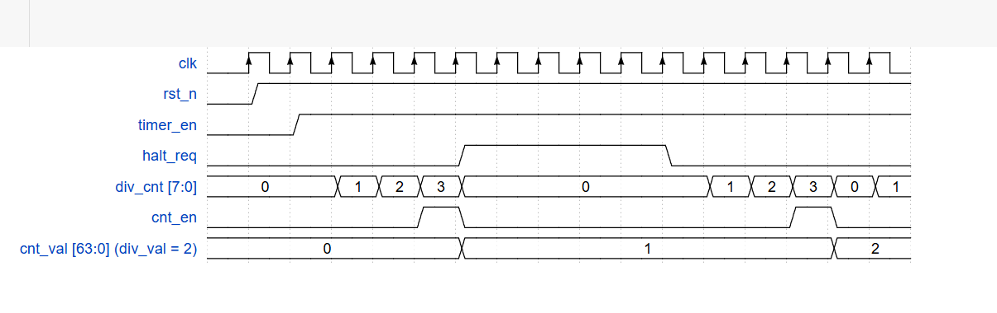
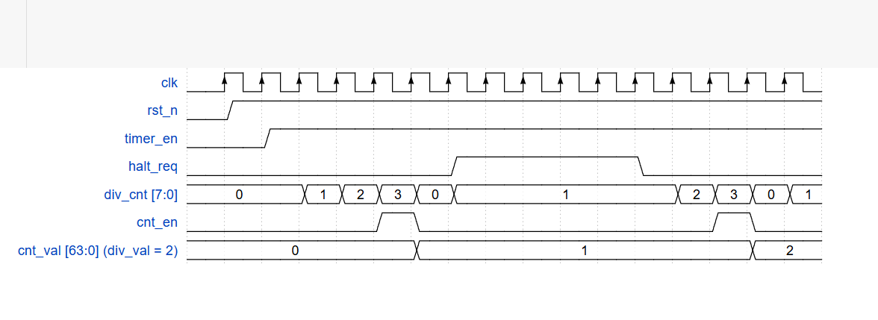
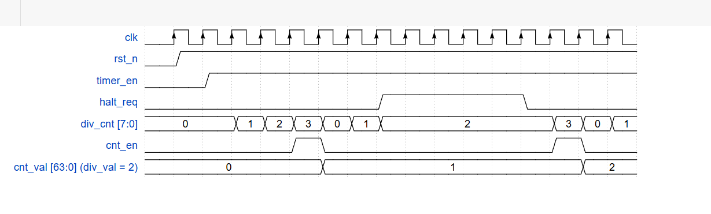
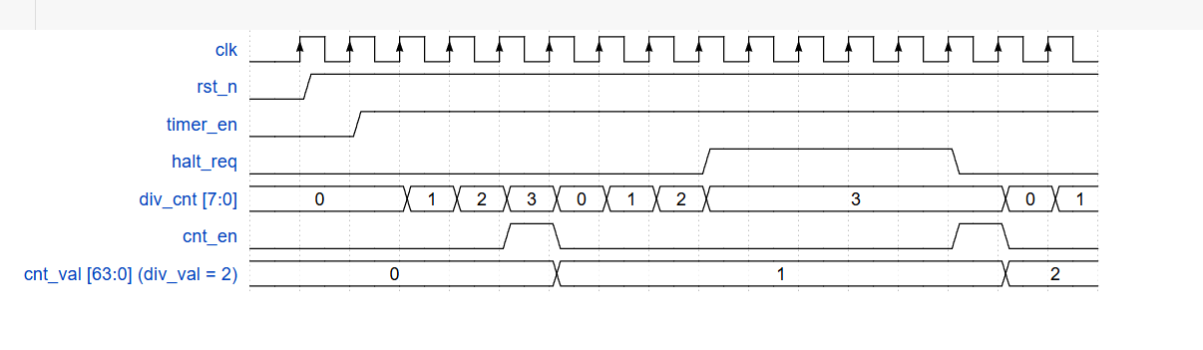
2.4. Waveform – Halt mode
1
2
3
4

Slide 34
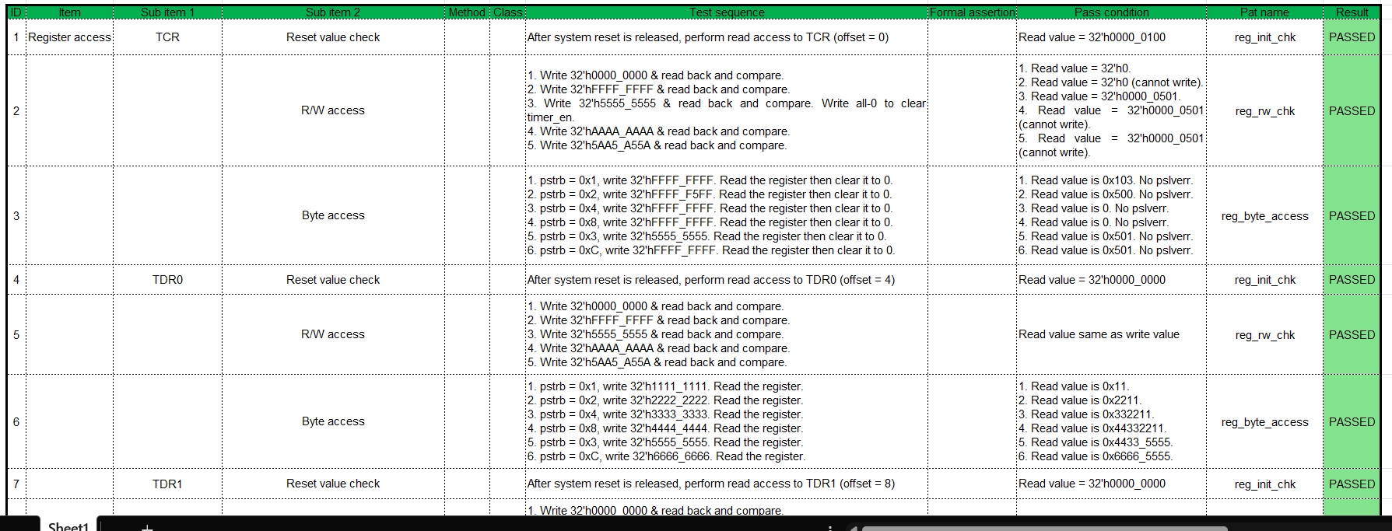
3.1. Verification plan
The full verification plan is attached to this Excel file:

Slide 35
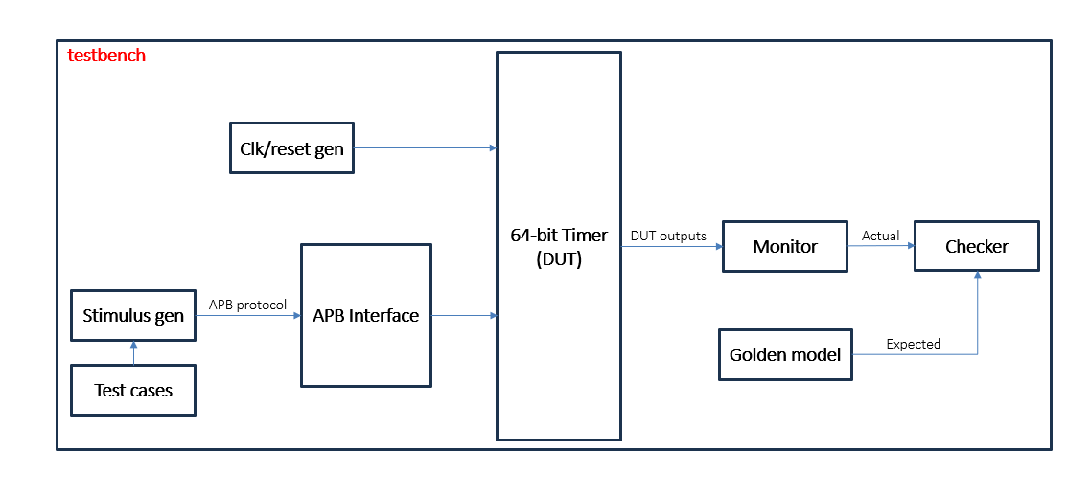
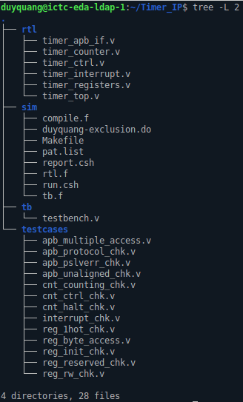
3.2. Verification environment
Verification environment for 64-bit timer
Timer IP project structure

Slide 36
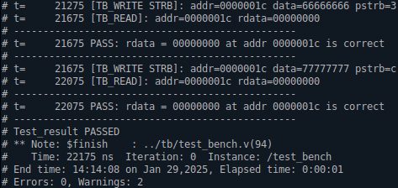
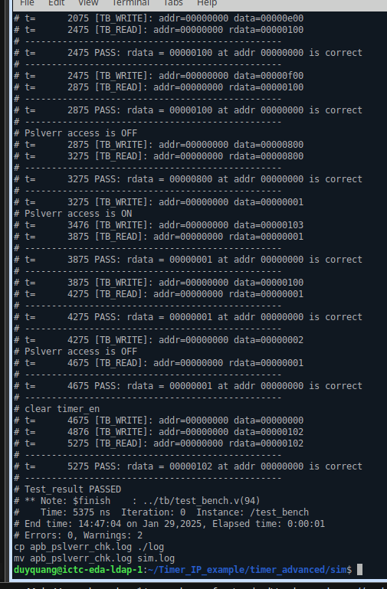
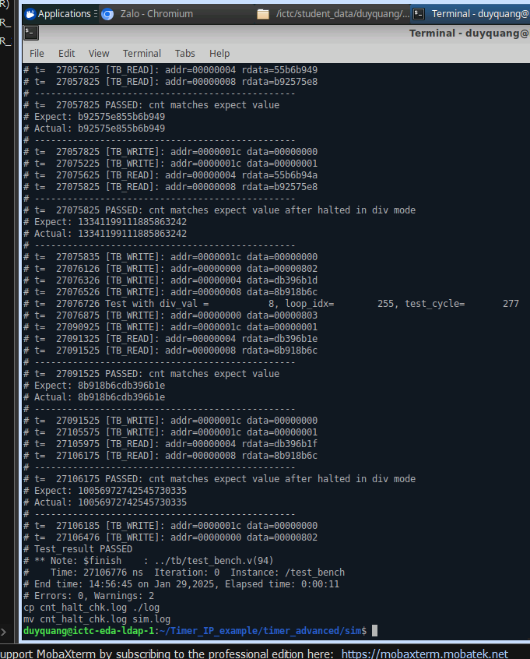
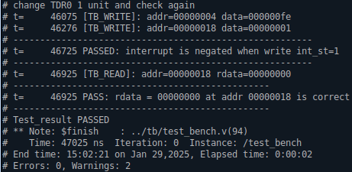
4.1. Golden model result
Here are some test cases’ results of the golden model:
1
reg_byte_access.v
2
apb_pslverr_chk.v
3
cnt_halt_chk.v
4
interrupt_chk.v

Slide 37
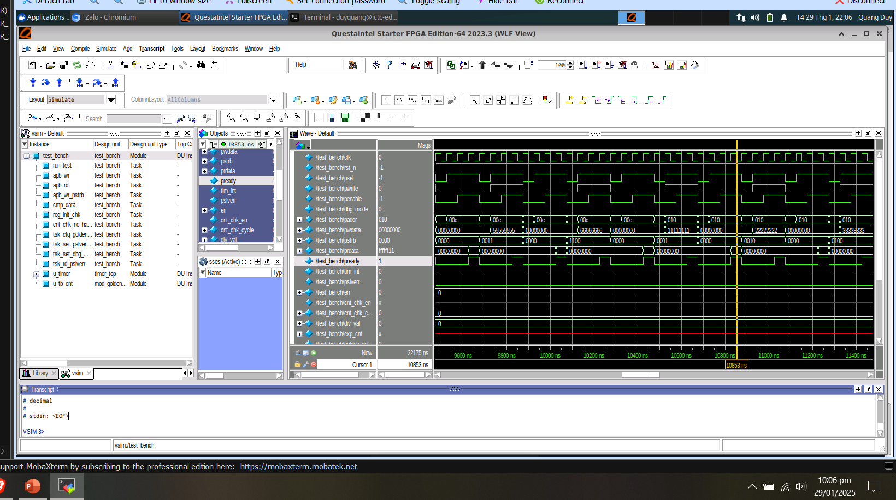
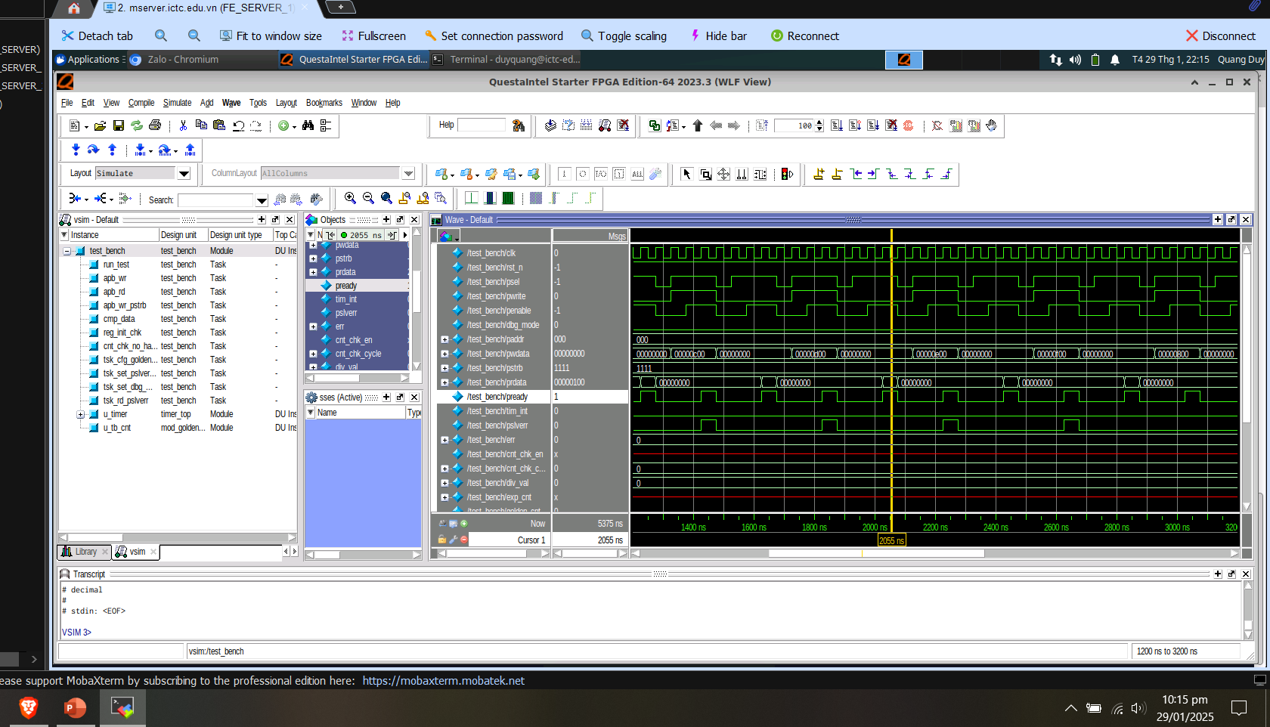
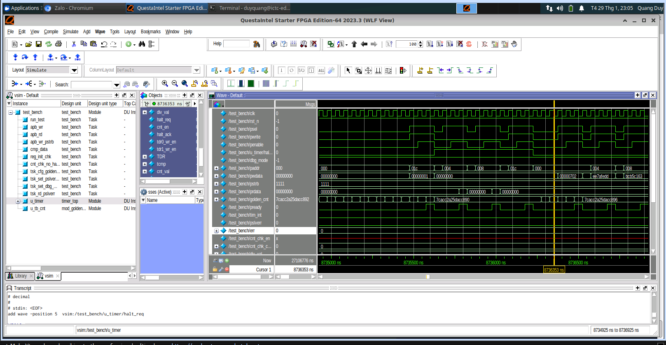
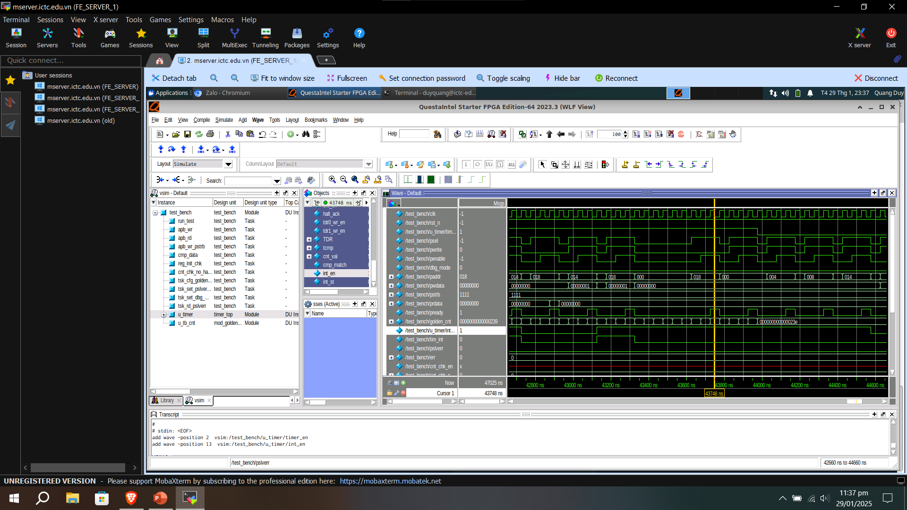
4.2. Simulation waveform
Here are some test cases’ simulation waveforms:
1
reg_byte_access.v
2
apb_pslverr_chk.v
3
cnt_halt_chk.v
4
interrupt_chk.v

Slide 38
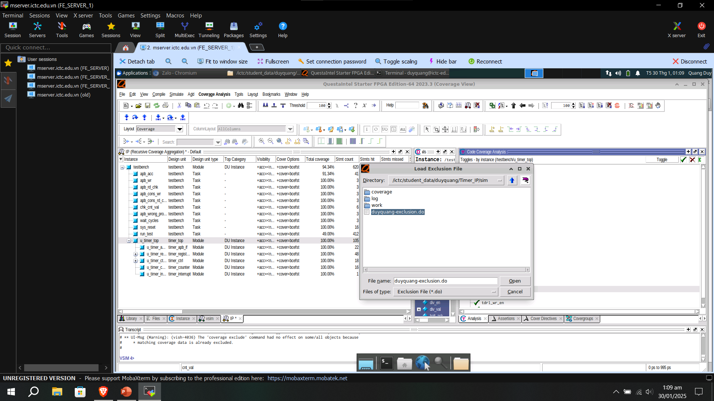
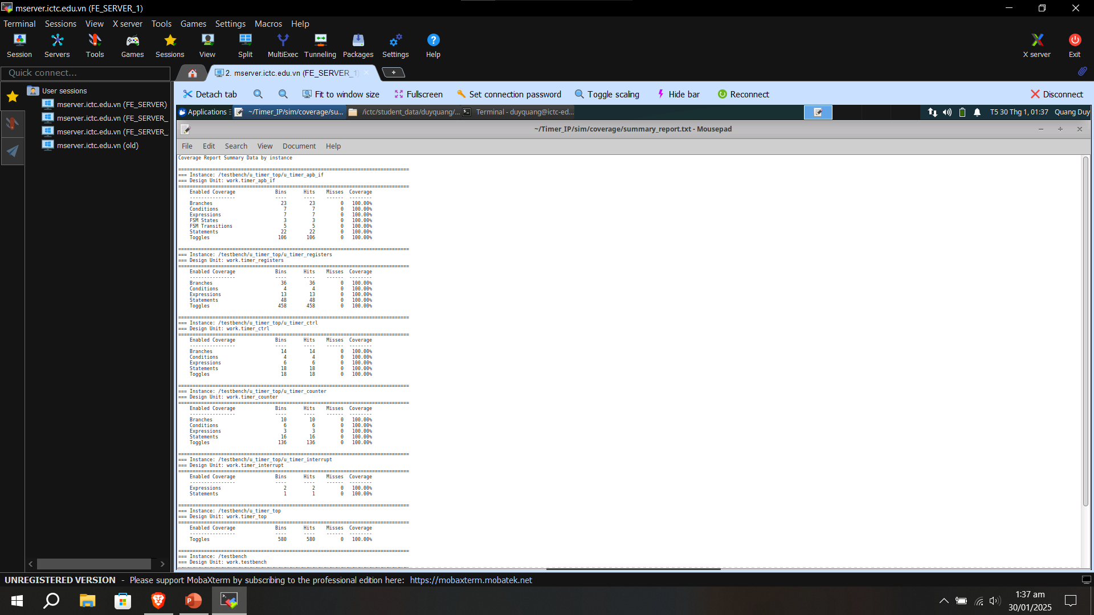
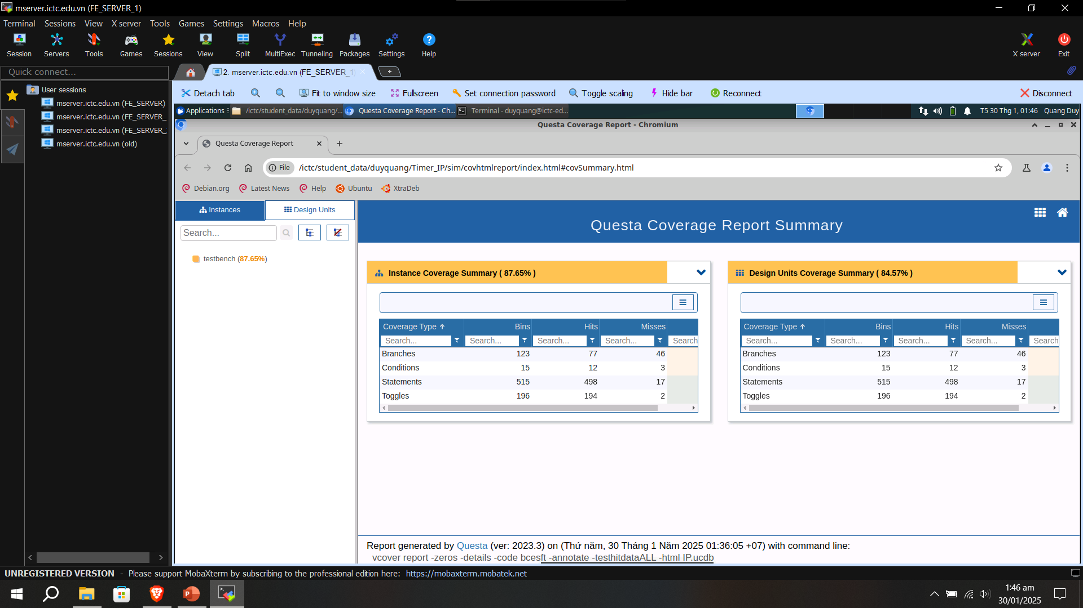
4.3. Coverage result
1
Load “Exclusion File” (*.do) with appropriate reasons
2
Coverage text reports: Achieve 100% coverage of DUT
3
Coverage HTML reports: Achieve 100% coverage of DUT

Slide 39
THANK YOU

